Slide 1
IOT Analytics
Our Expertise, Your Home
Jeroen Meij

Slide 2
Agenda
1
Daily insights
2
Weekly insights
3
Yearly insights
4
Forecasting electricity consumption

Slide 3

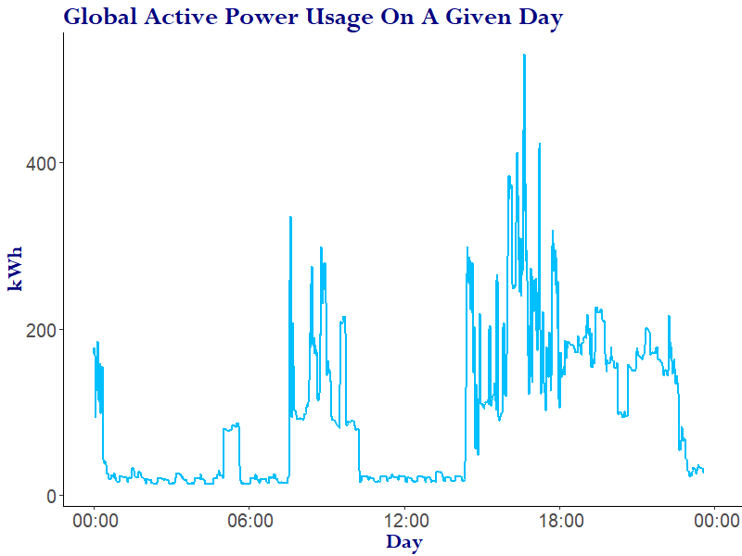
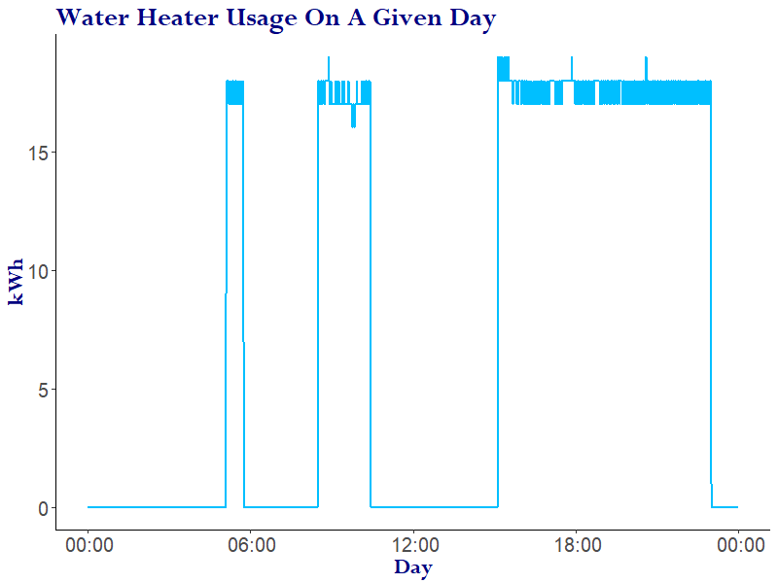
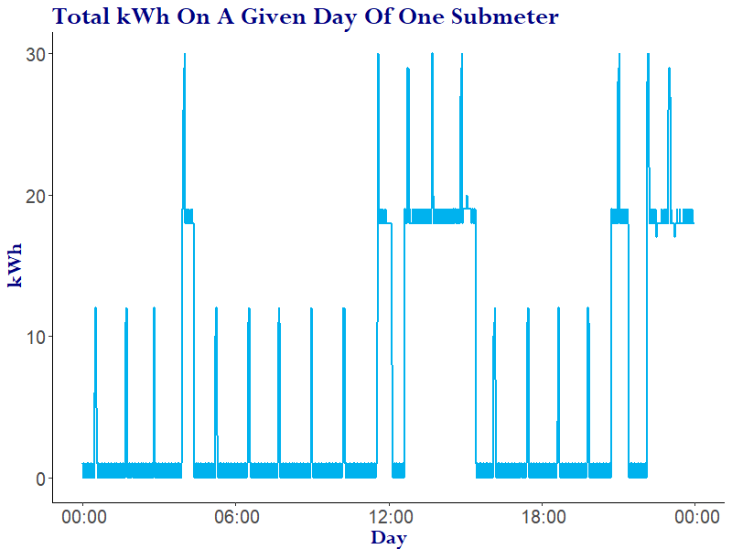



Daily insights
Obtain data
Obtain data
ON
Subdivide and Group
Subdivide and Group
ON
Analyze the patterns
Analyze the patterns
OFF
Transform to appeal
Transform to appeal

Slide 4

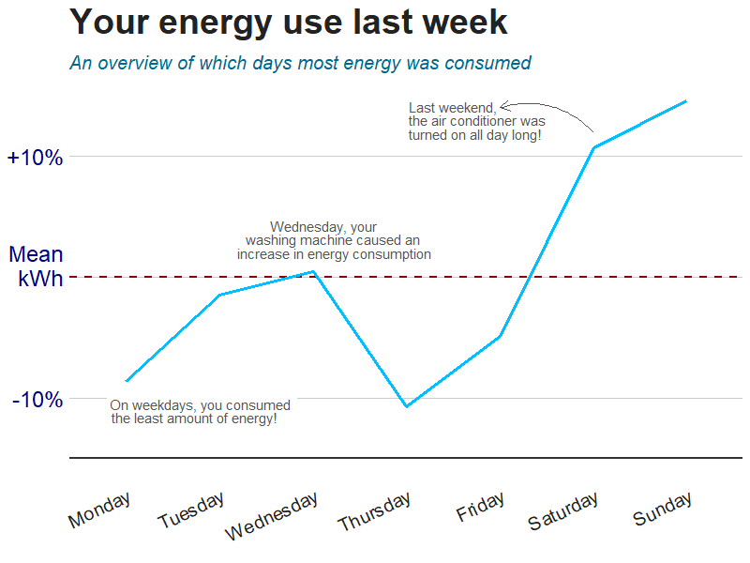



Week in week out statistics
14:34
Coffee machine
Your energy
use last week
“I like coffee”
- John F. Kennedy
Congratulations! You’ve consumed a lot less energy using your coffee machine than the national average!
You are awesome! ;-)
To celebrate, you can get Pickwick tea at Albert Heijn this week for 50% off.
Keep up the good work!
This week
20 min
50 min
0.2 kWh
Last week
1 hour
2 hours
0.6 kWh
In use
Country
Average
kWh
consumed
15%
Heating
55%
Laundry
Room
30%
Kitchen

Slide 5
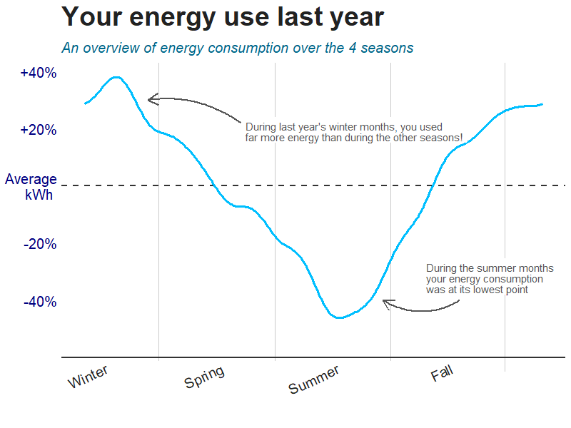
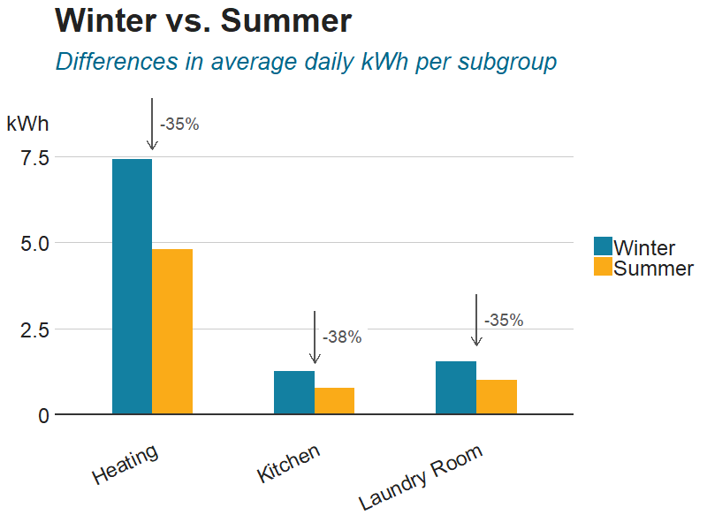
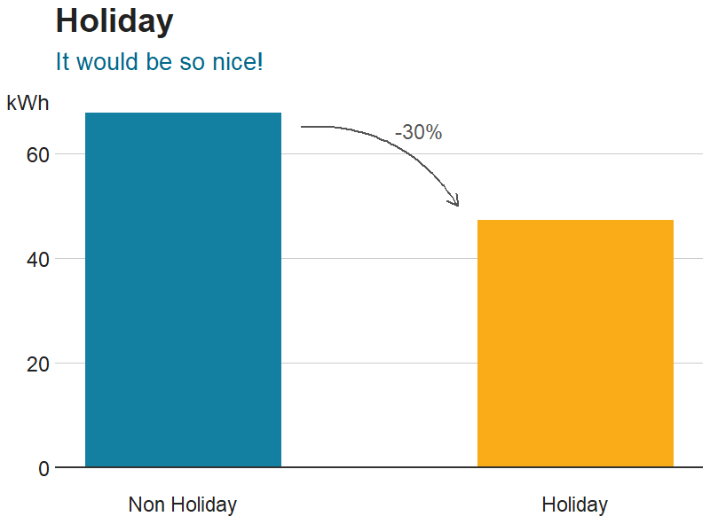





Yearly consumption and holidays
Wow!
Progress
Barcelona
During your holidays u saved enough on your electricity bills to buy a train ticket to Paris!
Book Now?
Or
Save for other destinations?
Milan
New York
Paris
“The sky is the limit” - Obama

Slide 6








Setting goals using our forecasts
A trip abroad
New electronics
Use vs forecast
Used so far
(kWh)
Our forecast
(kWh)
Money saved
(USD)
Saved
Progress
Still required
Today
45 50 $0,80
77 103 $3,50
340 410 $19,-
934 4670 $724,-
A night out
A book
$1300,-
$950,-
$50,-
$0,-
$250,-
Phillips TV
This week
This month
Iphone X
This Year
His/her education
Roomba
Charity
Airpods
Order

Slide 7



Summary
On Off

Slide 8
Thank you

